Slide 1
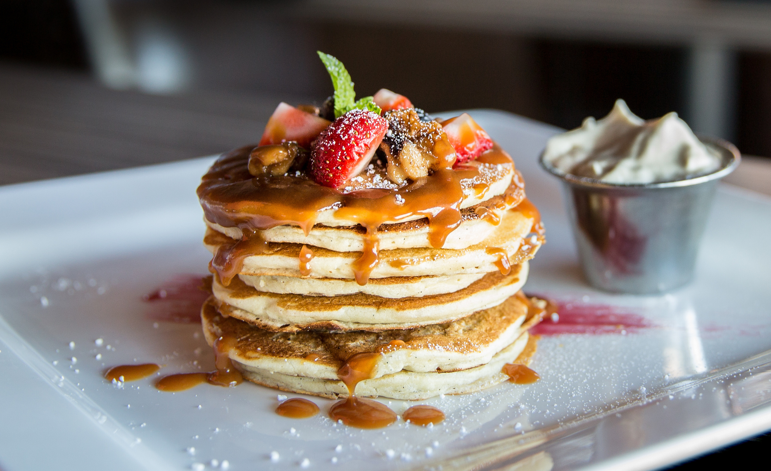
FlavorFusion: The RecipeLab
An app designed to generate recipes tailored to your demand
Arya Sheth
Notes:
The biggest problem we face every day - What do you want to eat. I ask this question at least twice a day. I am sure, you do that too. Say it is raining and the it will take at-least 50 mins for your food to get delivered or its 23:00 hrs and everything around you is closed so all you can do is to cook some food at home.
You have some deficiencies or are just trying to live a healthier life and want to track the nutrients

Slide 2


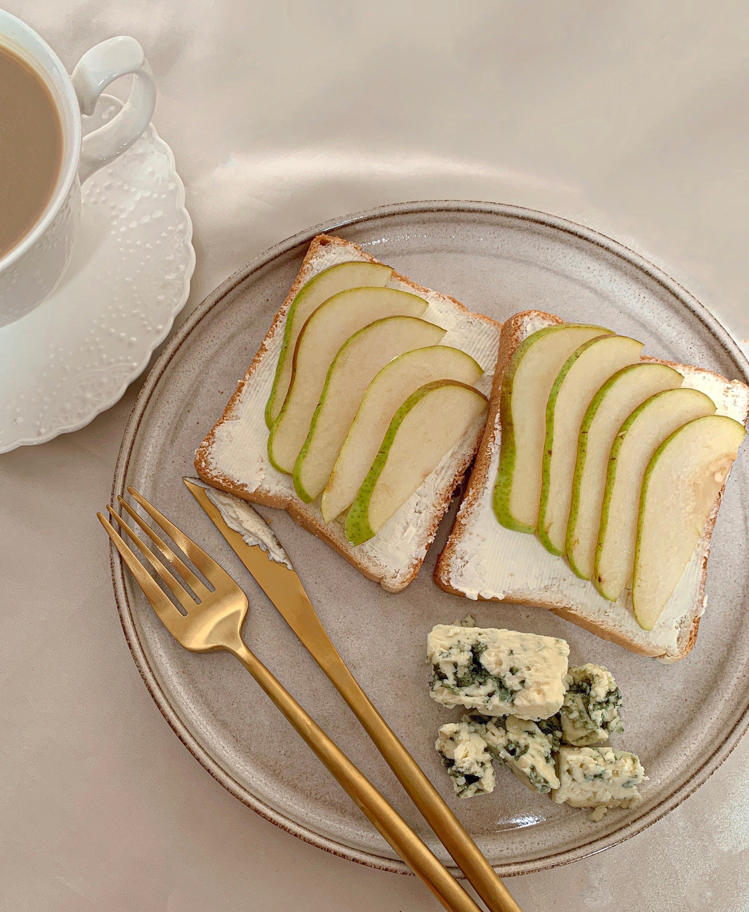
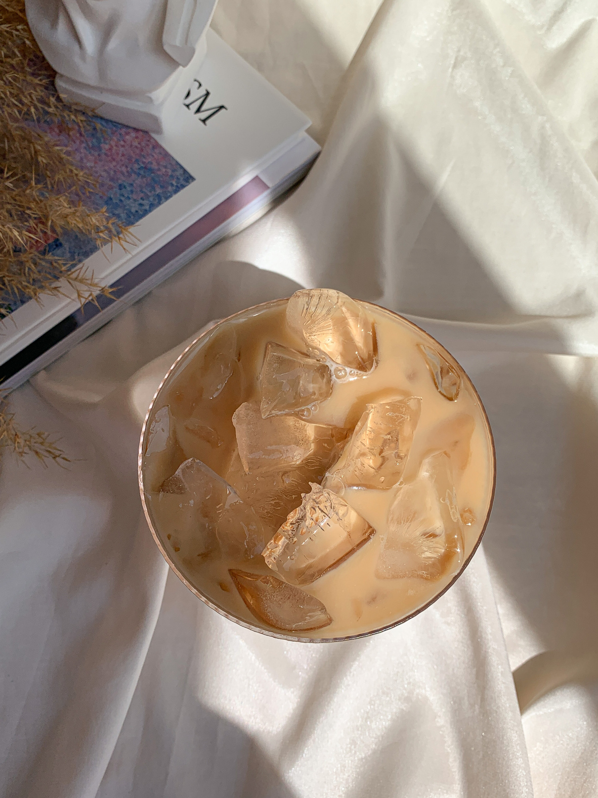

Table of
Contents
Business case
About FlavorFusion
Product features
About the Data
Future plans

Slide 3
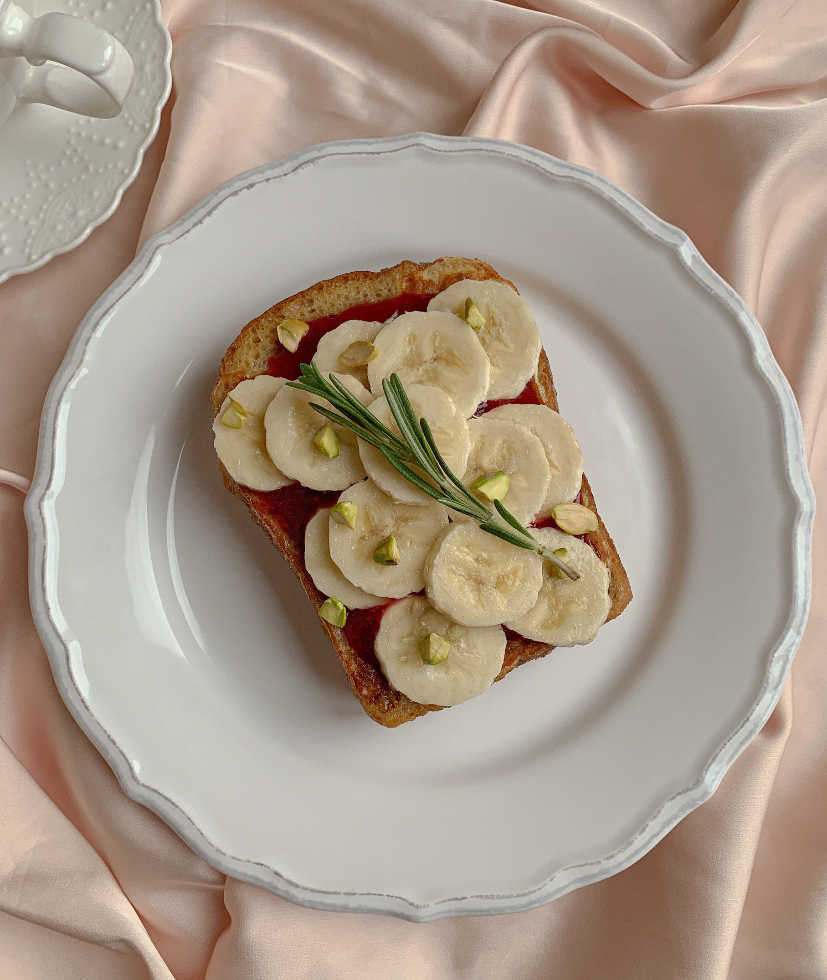

BusinessCase
Problem Statement: The dilemma from using the recipe suggestion apps presents a choice between perusing through recipe collections, identifying an appropriate recipe that maximally utilizes available ingredients, and subsequently procuring the missing components, or alternatively resorting to food delivery services. The latter option, however, might not align with personal nutritional goals
Existing Solutions: Presently, platforms such as Supercook exist, which allow users to input available ingredients and generate compatible recipes. Nevertheless, these solutions are deficient in providing comprehensive nutritional insights such as protein content and calorie counts.
Notes:
Agreed that there are tons of apps that give you suggestions about the recipes to follow. Some may even provide you with the nutritional information as well. But what if you have a few veggies of raw material so to say left over at home and you want to make something out of it. What would you do then? Scroll through the recipes on this app , find the one that uses most of the things that you have at home and go and buy or order the remaining ingredients? Or just forget about it and order food? then what about your nutritional goals?
Agreed that there is a website called supercook but it doesnot provide the protein content or calories in that dish
So I came up with this idea of providing you with Flavor fusion, which combines both, recipe and nutrition suggestions

Slide 4

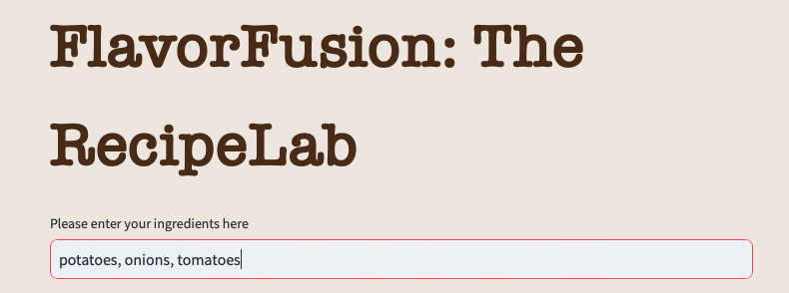
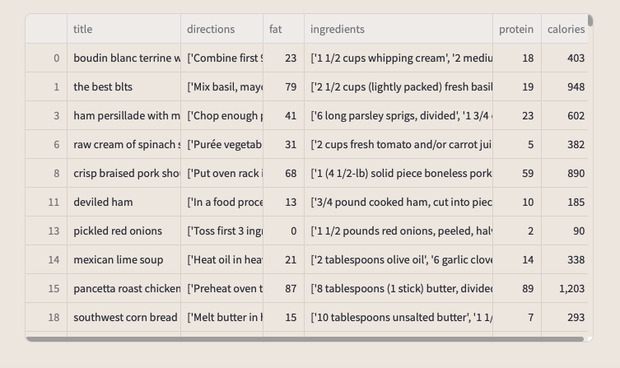

FlavorFusion
Gives you exactly what you asked for : Provides the recipes based on the inputs of users
Reduced Food Waste: FlavorFusion's emphasis on utilizing available ingredients reduces food waste, contributing to sustainability efforts
Informed Choices: Users can make informed decisions that align with their nutritional objectives, facilitating healthier eating habits
Enhanced User Experience: By combining recipe suggestions with comprehensive nutritional insights, FlavorFusion offers a comprehensive and user-friendly culinary solution
Notes:
The proposed solution, "Flavor Fusion," seeks to bridge the gap between recipe recommendations and nutritional information by offering users a holistic culinary experience. By incorporating both recipe suggestions and comprehensive nutritional data, users can make informed decisions that align with their dietary preferences and goals.

Slide 5
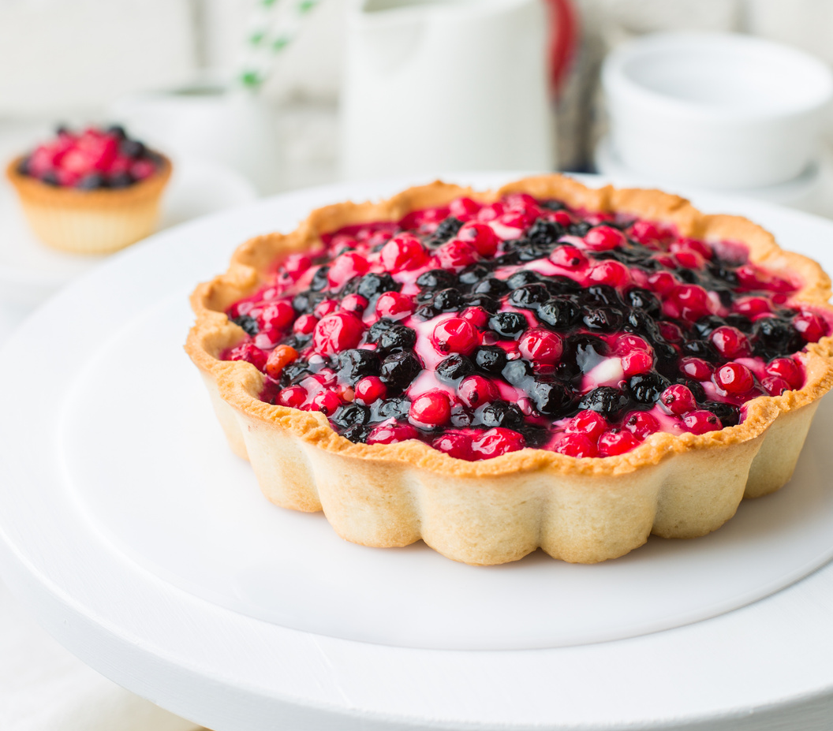
Product
Features
Nutritional Insights: FlavorFusion will provide detailed nutritional information for each recipe, encompassing protein content, calorie counts, vitamins, and more. This information empowers users to select dishes in accordance with their dietary requirements.
Control over suggestions: You can choose from the options if you want a recipe with similar nutritional value or just the main ingredients
Personalization: Users can input specific dietary restrictions, preferences, and goals to receive recipe suggestions that align with their individual needs.
Shopping List Integration: For ingredients not already available at home, the platform will facilitate the creation of shopping lists, streamlining the procurement process.
Notes:
In conclusion, Flavor Fusion addresses the existing gap between recipe recommendation platforms and nutritional information. By offering ingredient-based recipe suggestions complemented by detailed nutritional insights, this innovative solution empowers users to craft meals that not only suit their taste preferences but also align with their dietary goals. Flavor Fusion represents a significant step forward in revolutionizing the culinary experience for individuals seeking both flavorful and nutritionally balanced meals.

Slide 6


About the Data
Dataset : 'Epicurious - Recipes with Rating and Nutrition’
Problems: Dataset contained incomplete information and some recipes were in foreign language with foreign characters
Methods used : Clustering a. Kmean
b. Gaussian Mixture
c. Birch
Model used for the app: Kmean (current version)

Slide 7
Future
Plans
Q3 2023: New version of app
Q4 2023: Add new recipes
Q1 2024: Add games in the app
Concept: you can tell if you want to eat something sweet or spicy and the app will suggest cusines and recipes
Q4 2024: Go global

Slide 8
Thank you !

Slide 9
Questions

